Slide 1
Tweeting and teaching: how scholarly is social media?
Claire Warwick
Professor of Digital Humanities
UCL Department of Information Studies

Slide 2
Picturing our assumptions
What is digital scholarship?
Impact on scholarly practices
Technology or culture?
What changes? What remains?

Slide 3
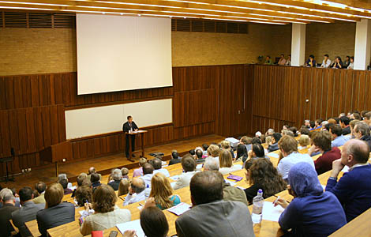
This is what we do in HE
Notes:
The classic lecture- what we do, but don’t really ask why
Not ideal, but least bad option

Slide 4
This is chatter
Notes:
Is this people chatting to one another instead of listening to presentations?
Whispering in class?

Slide 5
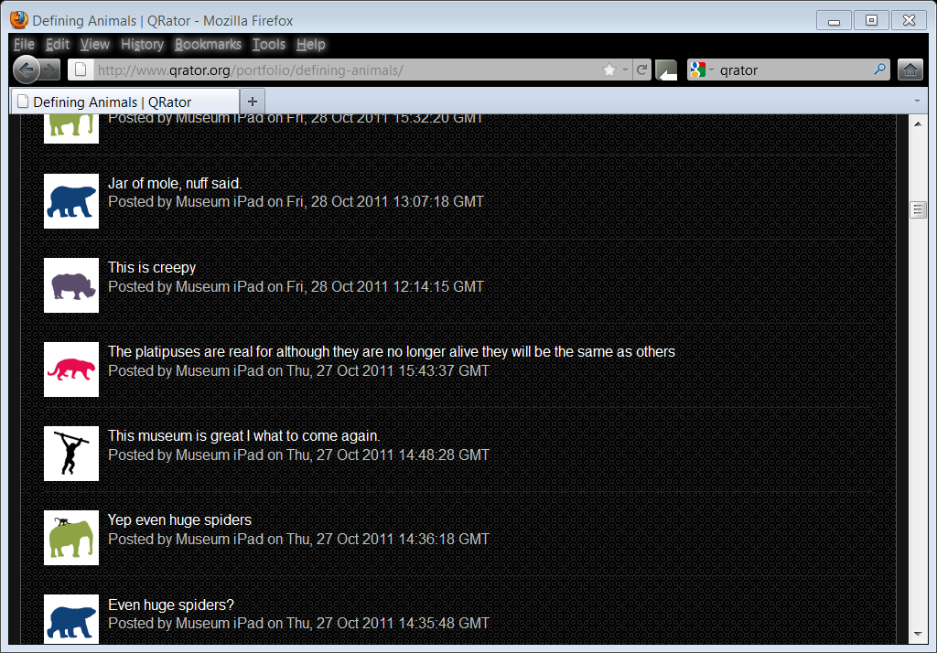
This is chatter
Notes:
Here’s what happens when you let people loose on a website- spam and silliness

Slide 6
This is what we do in HE
Notes:
Scholarly publications from an important research project

Slide 7
Why is this what we do in HE?
Notes:
Lacking in capacity, interactivity, ability to comment, time and place
Although you can keep an eye on people and make sure they understand

Slide 8
This is a scholarly channel
Notes:
more flexible
Genuine dialogue, including between readers,
can leave and come back- Stop and start, use as and where you want- can go on as long as you like
Don’t have to invite people, don’t know who’s there

Slide 9
This is digital interaction in a museum
Notes:
Talk about QRator
People do want to engage with questions and express views re museums
Remarkable lack of spam

Slide 10
This is crowdsourced scholarship
Notes:
TB shows what can be achieved if you allow people to take part in scholarly process- even if difficult

Slide 11
This is serious research
http://www.museums.ucl.ac.uk/research/ecurator/3Dobjectgallery.html

Slide 12
Creating New knowledge
VindolandaTablets

Slide 13
Creating New knowledge
© Centre for the Study of Ancient Documents, University of Oxford.

Slide 14
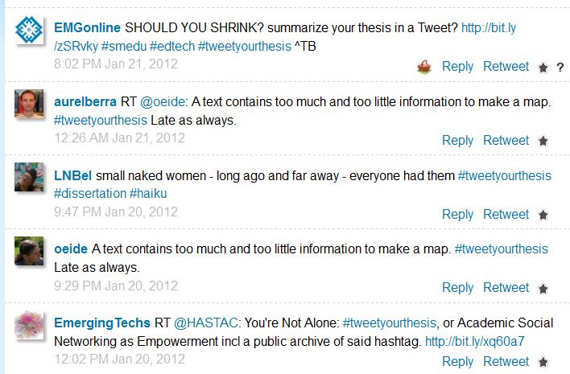
But is this?
Notes:
#tweetyourthesis
Scholarly concision or unscientific and dumb?
Medium or message predominates?
What happens when you take a scholarly principle onto social media

Slide 15
Experts and scholars
Communication does not = dumb
Books do not = research
Blogs do not = trivial
Tweets do not = chatter
Notes:
New forms of scholary communication possible
Cathy Davidson and student blogs
Still a lot of reaction going on

Slide 16
Implications for scholarship
Not (just) about the medium
Need to reconsider questions of authority
Participation and inclusiveness
Dialogues not monologues
Users and student not just experts and teachers

